Slide 1


Experience Maldives..!
OBLU-ailafushi.COM

Slide 2

Experience Maldives…!
KEY USPs
268 VILLAS IN 4 CATEGORIES including Duplex-Style Family Rooms
Flavorsome cuisine at Element X
Just 15-Minutes from Airport
Unique food truck dining experience at Copper pot food truck
X360 showcasing X360 Bar, X360 Pool and Beach and X360 Sports Bar
Largest Under Ocean Restaurant Only BLU
Sip, shop and socialize at the retail zone featuring - The Wine and Liquor Shop, The Coffee and Pastry Shop, The Essence OShop
Multi level kids club with pool with dedicated food corner for lunch
ELE|NA Spa Complex featuring a unique garden community spa
Weekly animation program with wellness and recreation activities
Over water Gym, Tennis court and football pitch
Daily live entertainment with live band, DJ and once a week cultural show

Slide 3
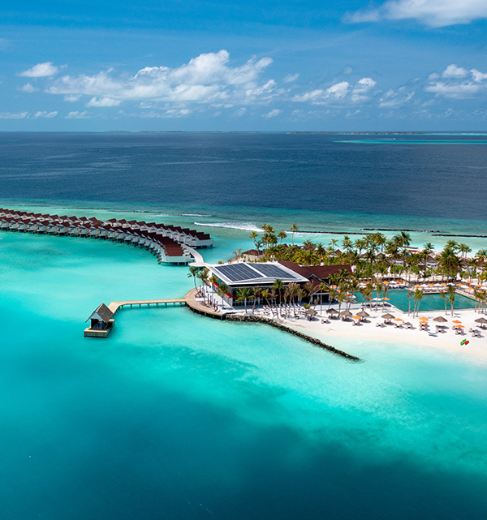
Ailafushi
XPERIENCE Maldives…!
OBLU XPERIENCE Ailafushi elevates tropical island living through smart services, playful design and invigorating experiences. In the Maldivian language of Dhivehi, ‘Aila’ means family and ‘Fushi’ means island. This laidback 4-Star Island Resort showcases 268 accommodation options in 4 categories. Experiential highlights include the fabulous La Promenade.
Our ultimate Fushi Plan™ creates a free-spirited Maldivian holiday experience for the modern traveller – be it families, couples or friends.

Slide 4
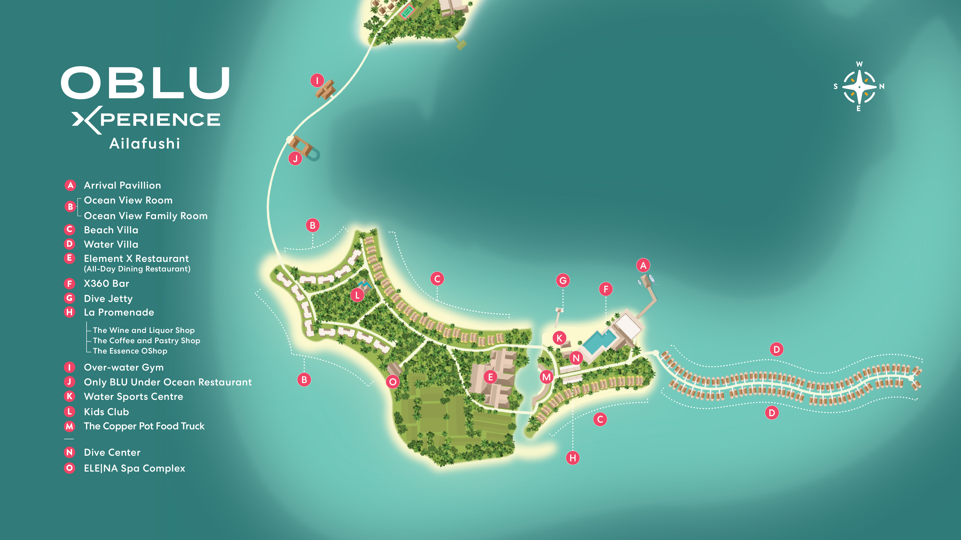

Slide 5
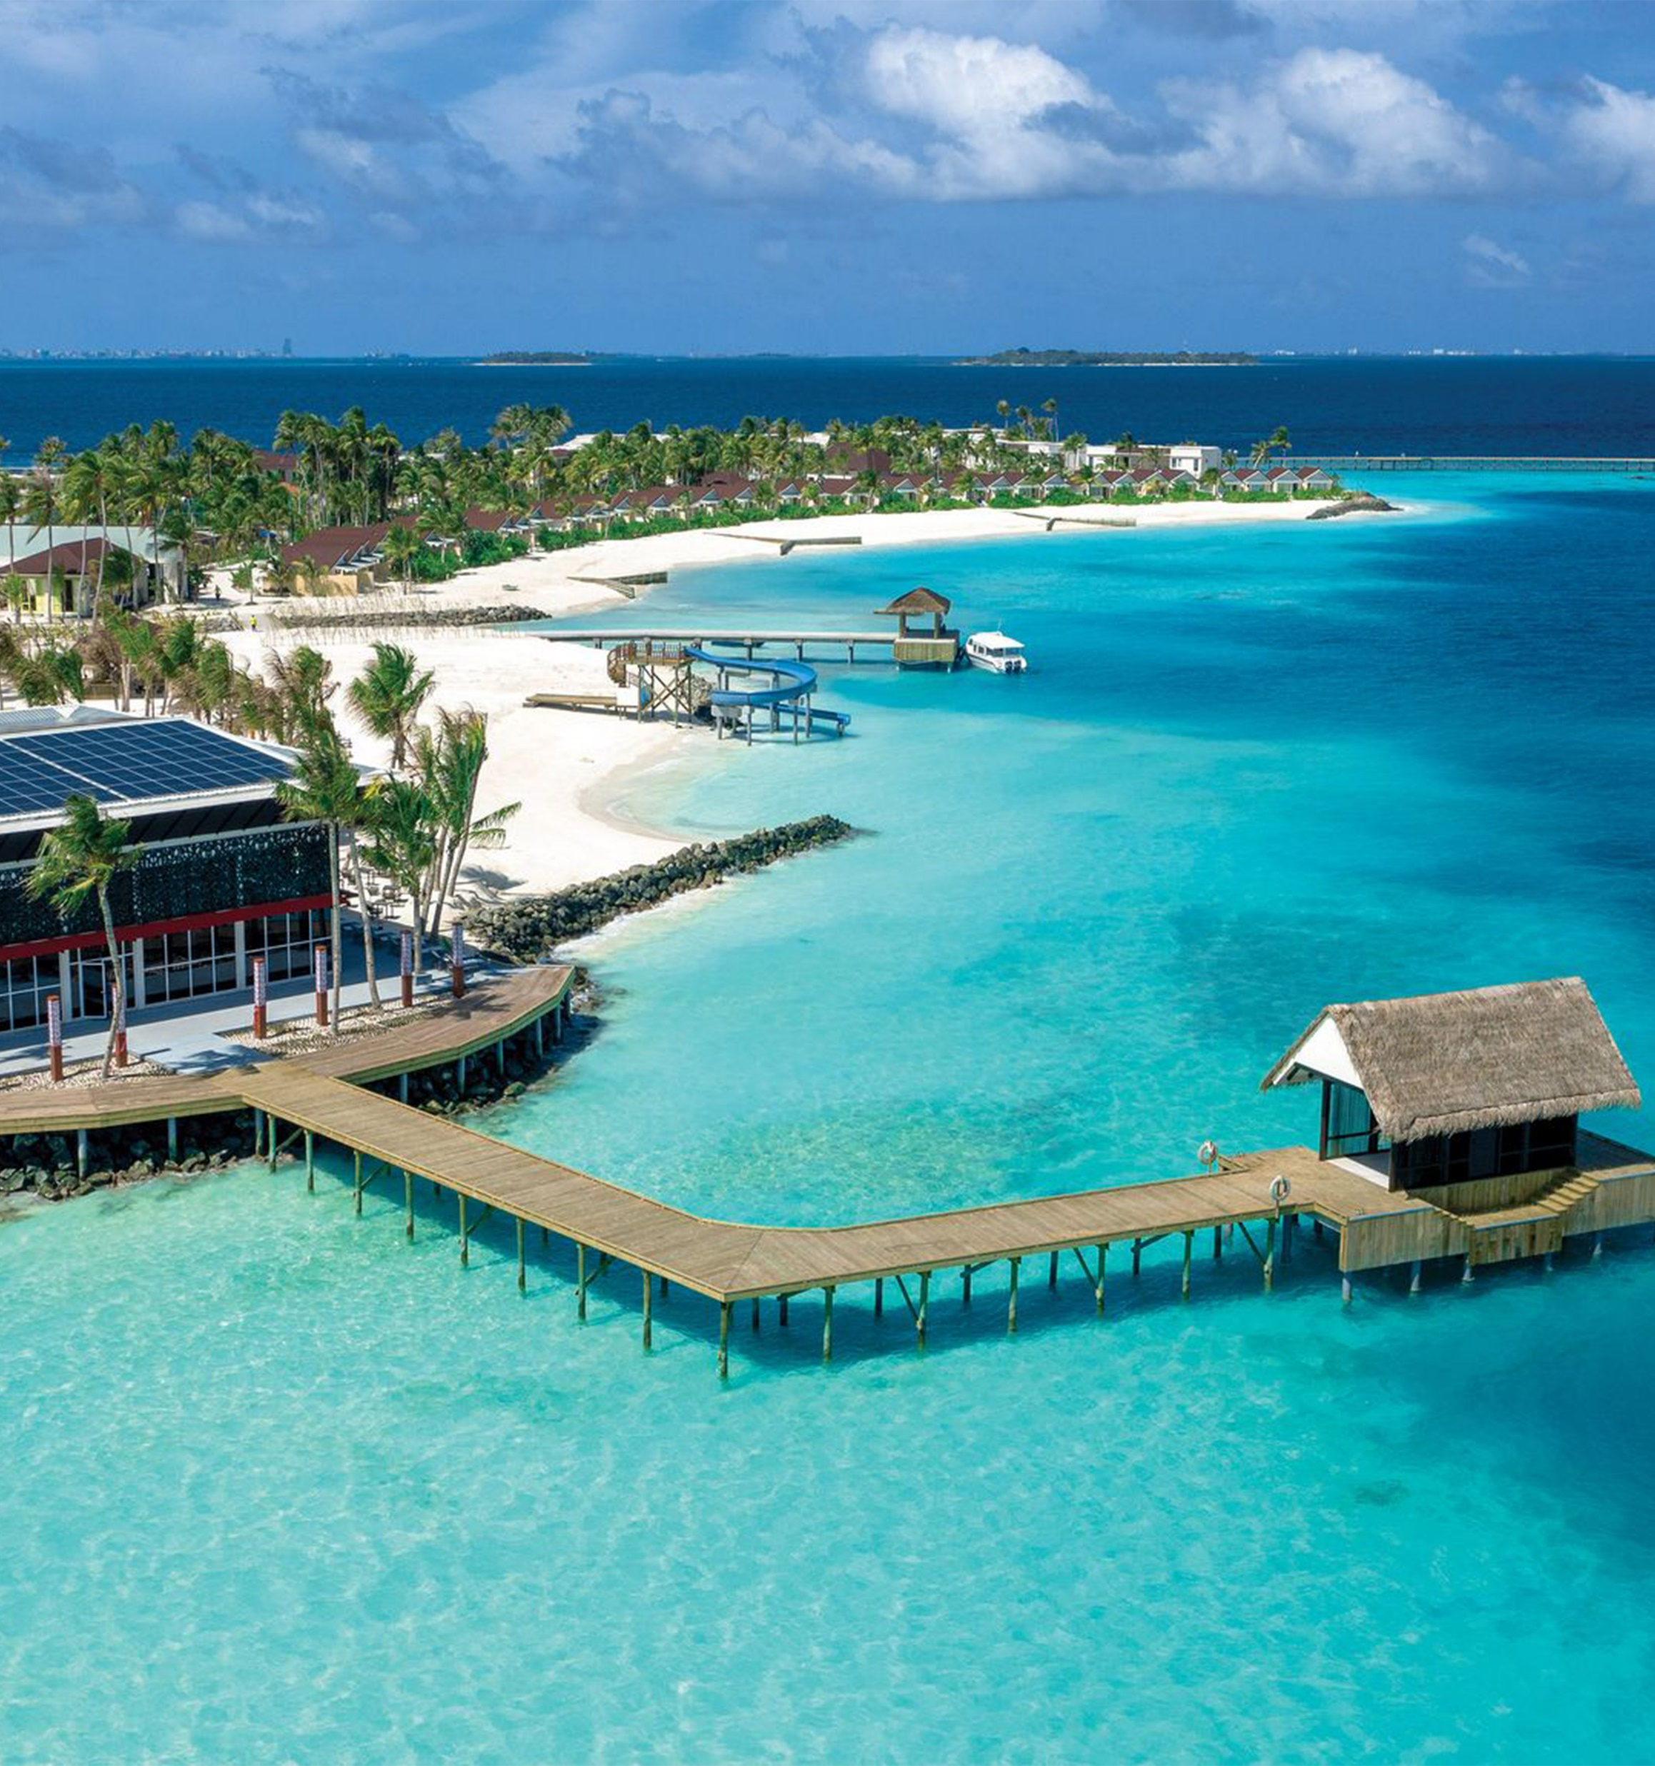
THE FUSHI Plan™
Arrival & Departure Experience
Complimentary airport transfer by speedboat on arrival and departure
Ailafushi island is just a 15-minutes Speedboat ride from Malé International Airport
Upon arrival, guests are received by the airport team and escorted to the speedboat jetty for transfer
Chilled water and refreshing face towels are served at the beginning of the short journey

Slide 6
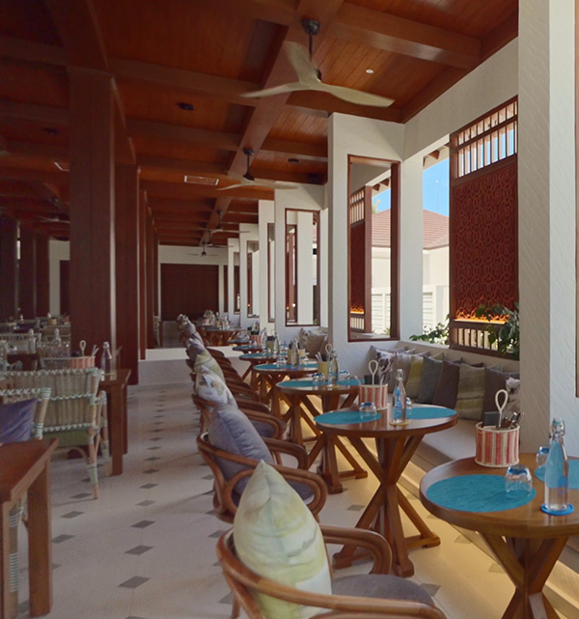
THE FUSHI Plan™
Dining Experiences
Breakfast, Lunch & Dinner served at ELEMENT X (All-Day Dining)
Self-assisted buffet and beverage counters with delightfully flavoursome feasts and a cold room with eye-popping delicious salad and dessert bars
A show cooking kitchen, laid out in five sections: Western, Eastern, Central, Cold Starters and Pastry, and Bakery
Self-service beverage counter with wine and juice dispenser, beer, soft drinks, coffee and tea.

Slide 7
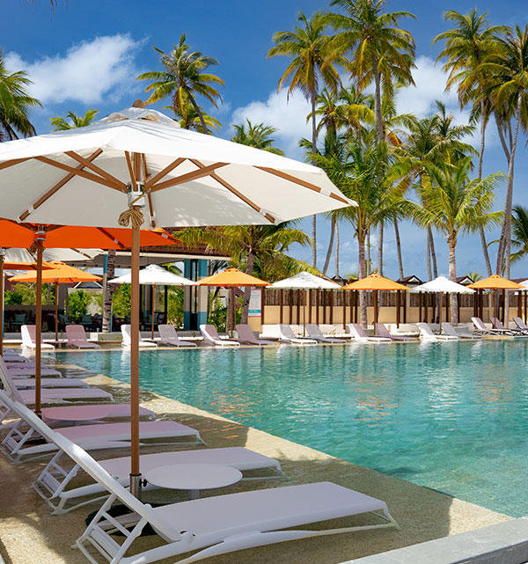
THE FUSHI Plan™
Dining Experiences
Drinks & Entertainment served at X360 (With Pool)
A limited service, vibrant main pool bar framed by scenic turquoise lagoon views. Bohemian décor and a friendly, sporty vibe in the upper deck area providing a multi-layered experience with popular indoor games. Daily evening entertainment with in-house DJ or live band and dance floor.
UNLIMITED orders of regular spirits and beers and house pour wines from the grab and go counter
ONE signature cocktail and ONE signature mocktail

Slide 8
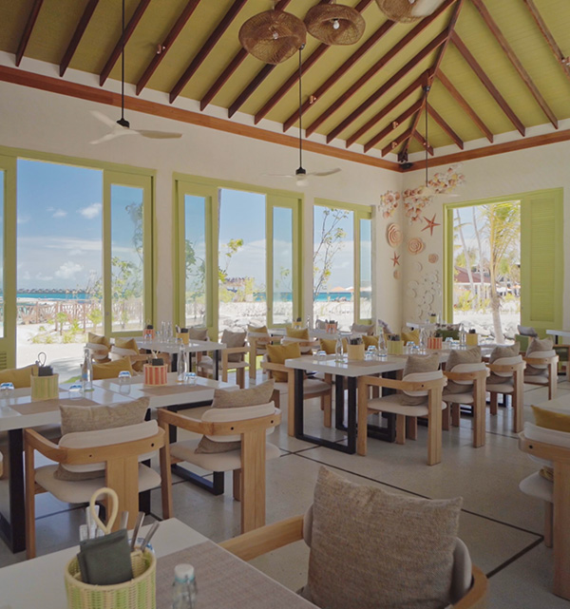
THE FUSHI Plan™
Specialty Dining
(Chargeable, not included within the Fushi Plan™. On pre-booking, based on availability)
The Copper Pot Food Truck - A refreshing Surf & Turf food truck experience featuring choicest fresh seafood and meat grills, to be relished on a soft sandy beach beneath the starry sky.
Snack Menu: 16:00 - 18:00 Daily
Only BLU (Specialty Dining - Under Ocean Restaurant) - Culinary extravaganza in a dream-like under ocean setting with window tables in this charming horseshoe-shaped restaurant. Relish impeccable modern gourmet fare and decadent desserts with a pairing of red and white wines, beer and soft beverages.
Prix Fixe menus with the option of Meat, Seafood or Vegetarian
Special kids menu available for families with kids available for lunch

Slide 9
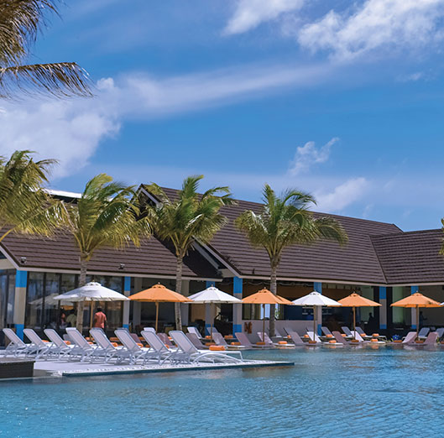
THE FUSHI Plan™
Beverages
UNLIMITED orders of regular spirits and beers and house pour wines from the grab and go counter at X360 Bar
ONE signature cocktail and ONE signature mocktail at X360 Bar
UNLIMITED House Pour Wines and Beers available at the self-assisted sections at Element X
Selected wine pairings at Copper Pot Food Truck
Soft drinks, mineralized water, pre-packet juices and an assortment of tea and coffee available at all outlets

Slide 10
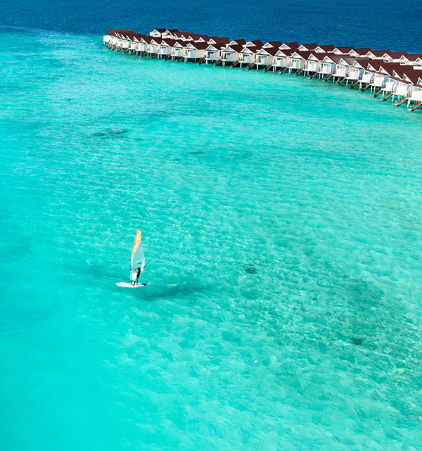
THE FUSHI Plan™
Activities & Adventure
Entertainment
DAILY live music performances with DJ and recreational activities at the X360 Bar
Gym And Recreation
UNLIMITED access to our fully equipped over water gymnasium
DAILY organized group activities
Water Sports
COMPLIMENTARY use of selected non-motorized water sports equipment - Kayak, SUP and Paddle board - maximum 15 minutes per person per day per each item

Slide 11
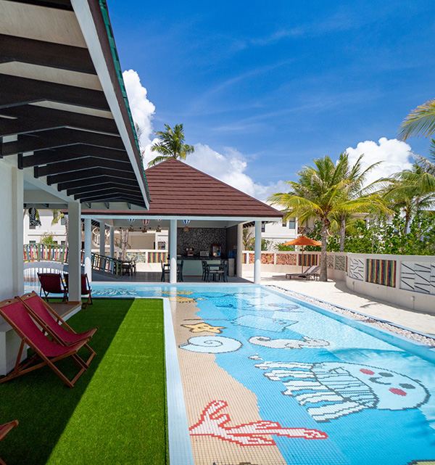
THE FUSHI Plan™
Activities & Adventure
Kids Club
Sprawling multi-level Kids Club with pool and buffet area
Host of fun activities and learning experiences organized daily for kids
ELE|NA THE SPA
(Chargeable, not included in the Fushi Plan™ )
Sustainable Community Spa Xperience and a range of Maldivian and international spa therapies

Slide 12
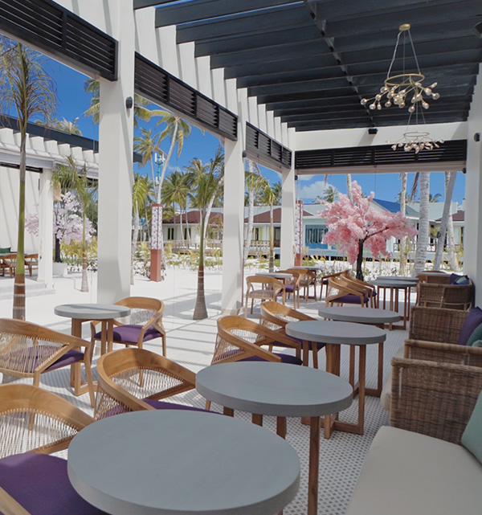
THE FUSHI Plan™
Other Services
La Promenade
Your heaven for sweet cravings, coffee addiction, sophisticated wine & premium liquor fantasies and minibar offerings
Select from our mouthwatering assortment of pastries to our thirst-quenching drinks all available on display around the shop
The Essence Oshop
Shop for delightful knick-knacks, beach essentials, and souvenirs

Slide 13
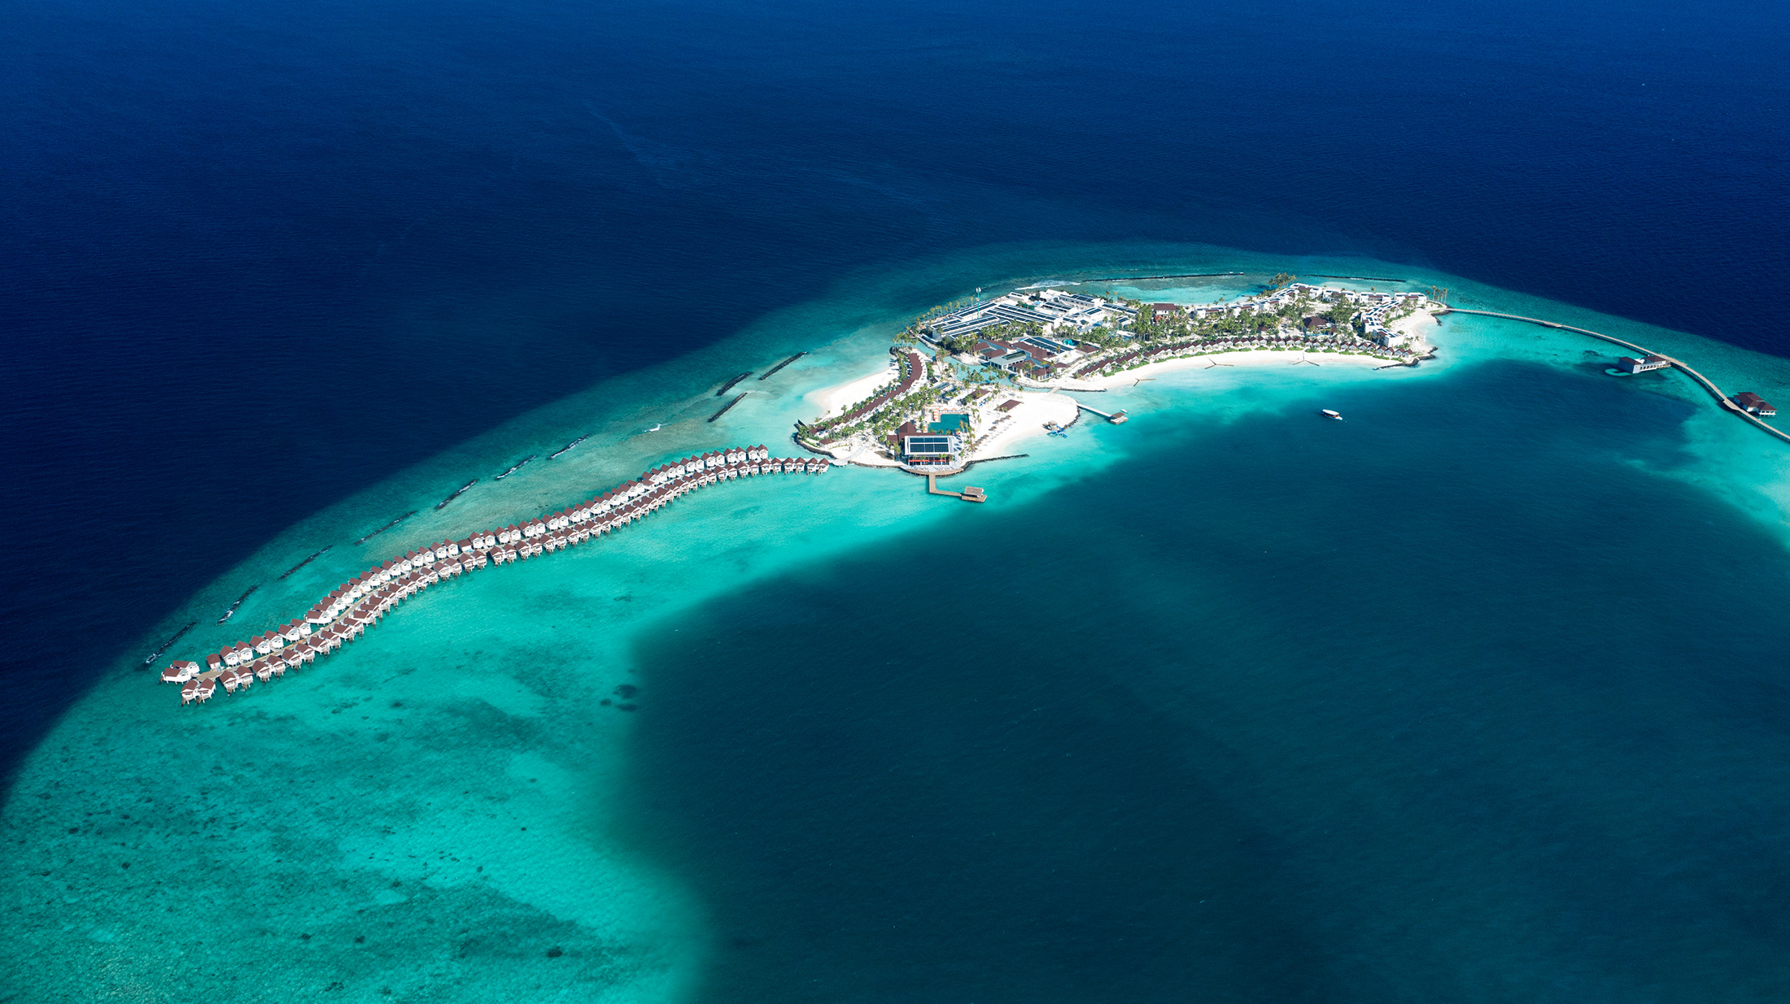
Full Resort Aerial View

Slide 14
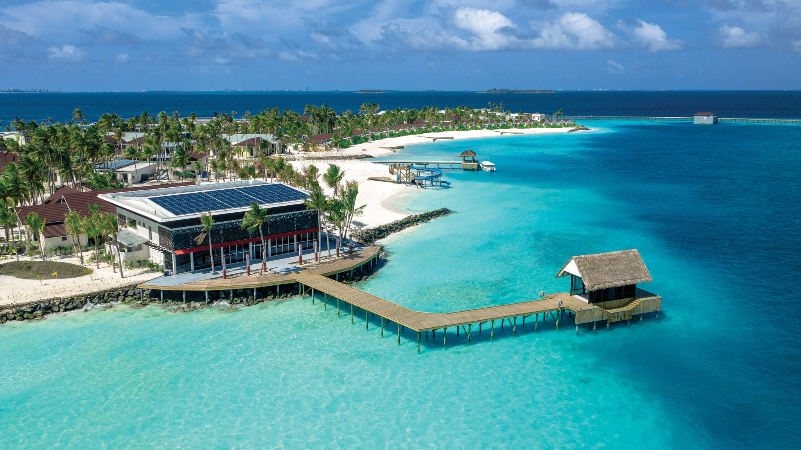
Arrival Jetty – Aerial View

Slide 15
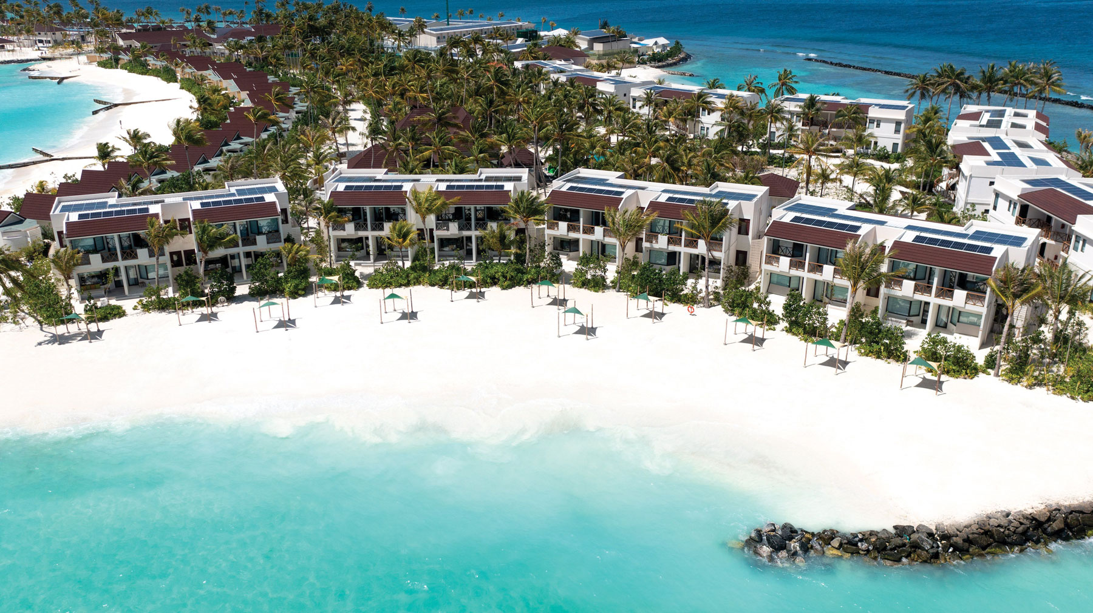
Ocean View Rooms & Ocean View Family Rooms - Aerial

Slide 16
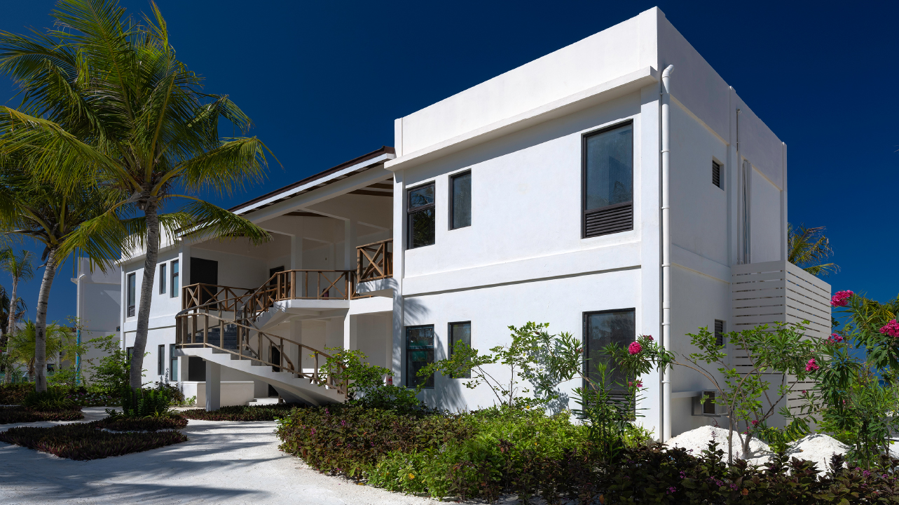
Ocean View Rooms & Ocean View Family Rooms - Exterior

Slide 17
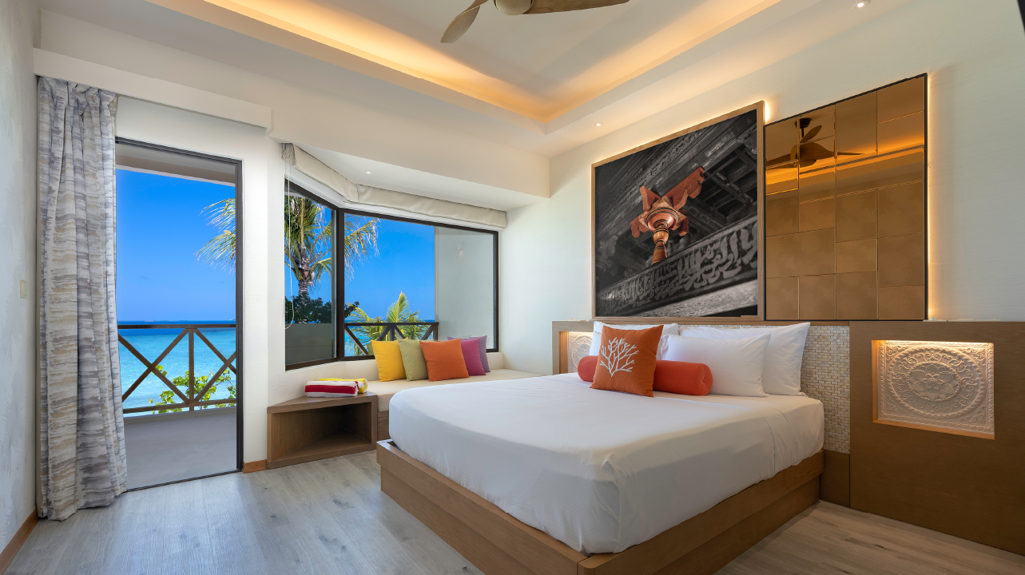
Ocean View Rooms – Bedroom with View

Slide 18
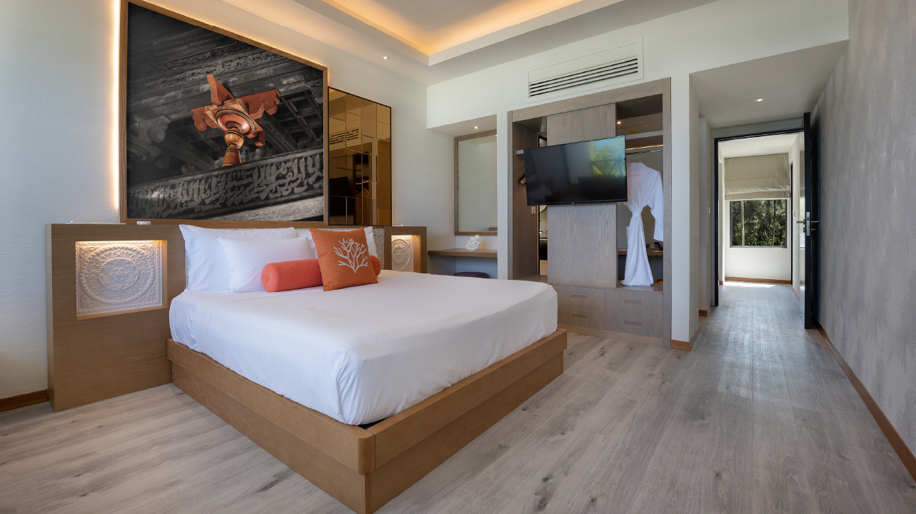
Ocean View Family Rooms – Bedroom

Slide 19
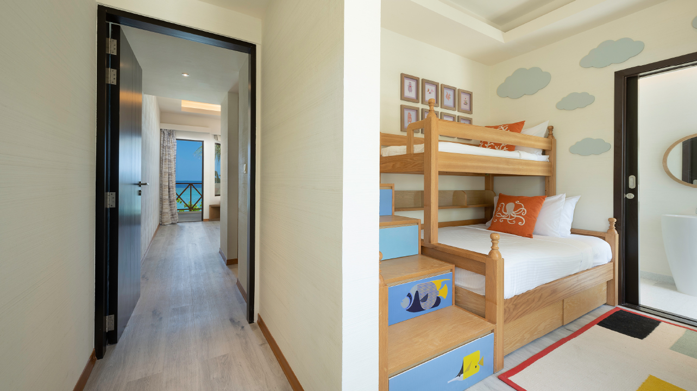
Ocean View Family Rooms – Kids’ Room

Slide 20
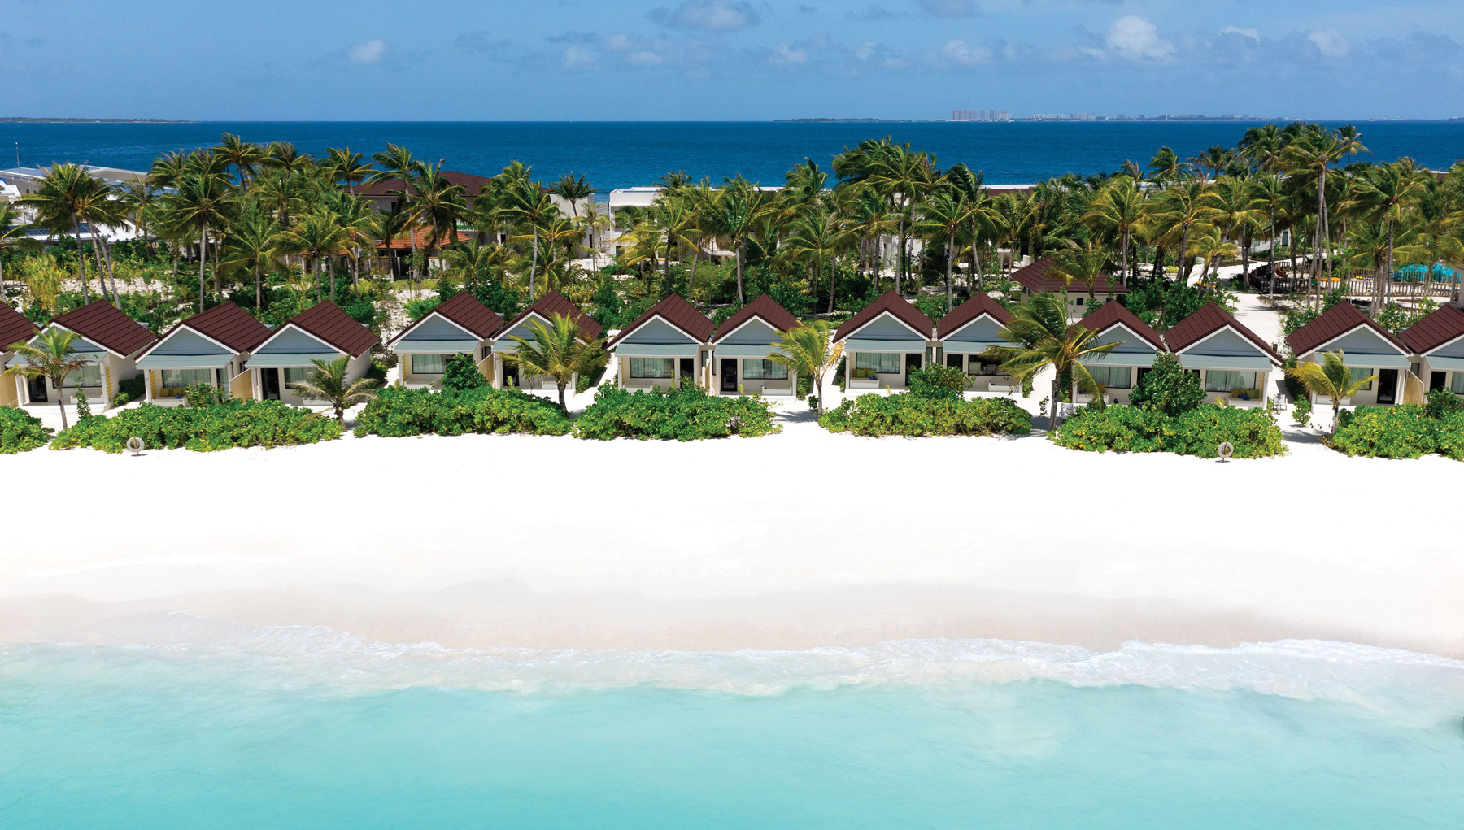
Beach Villa – Aerial view

Slide 21
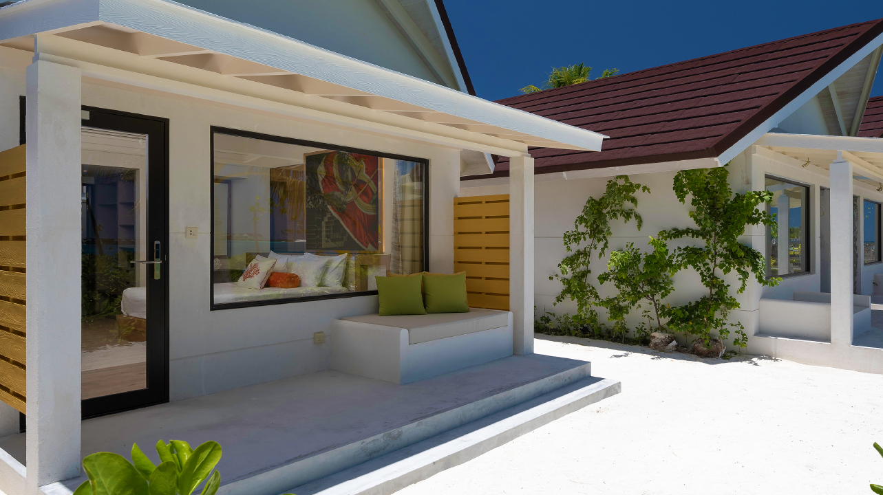
Beach Villa – Exterior

Slide 22
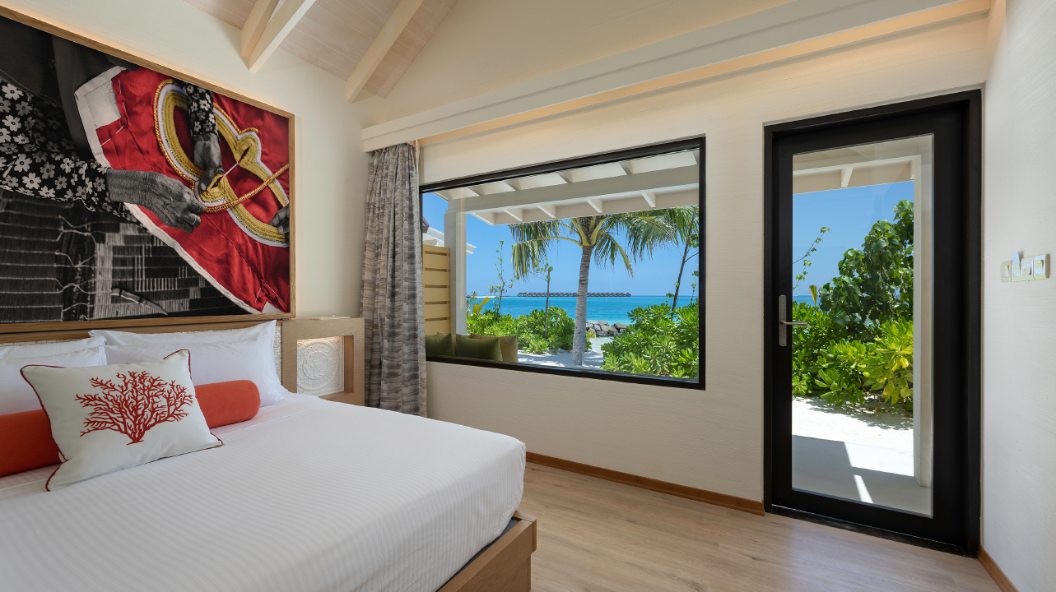
Beach Villa – Bedroom with View

Slide 23
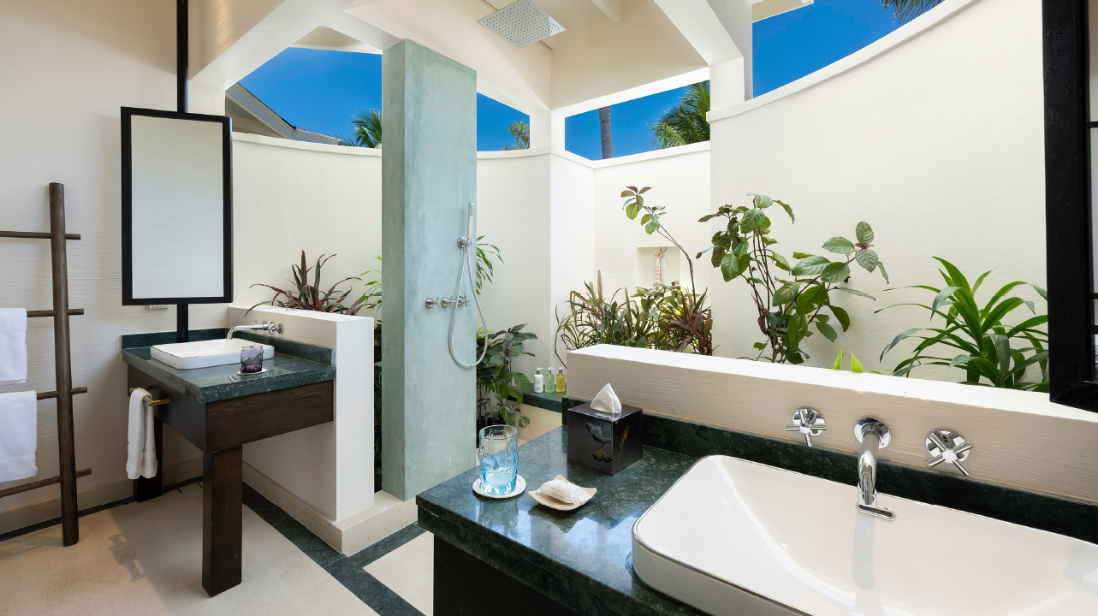
Beach Villa - Bathroom

Slide 24
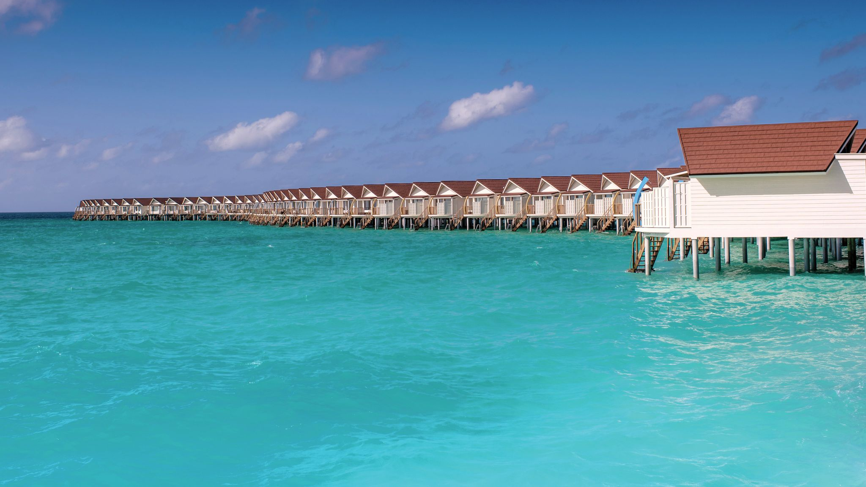
Water Villas – Aerial & Generic View

Slide 25
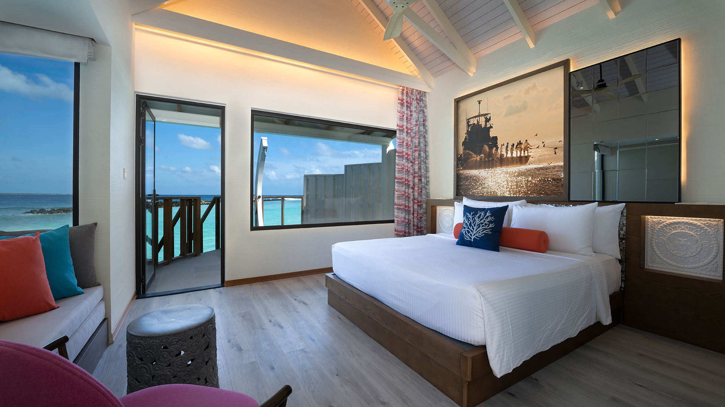
Water Villa - Bedroom

Slide 26
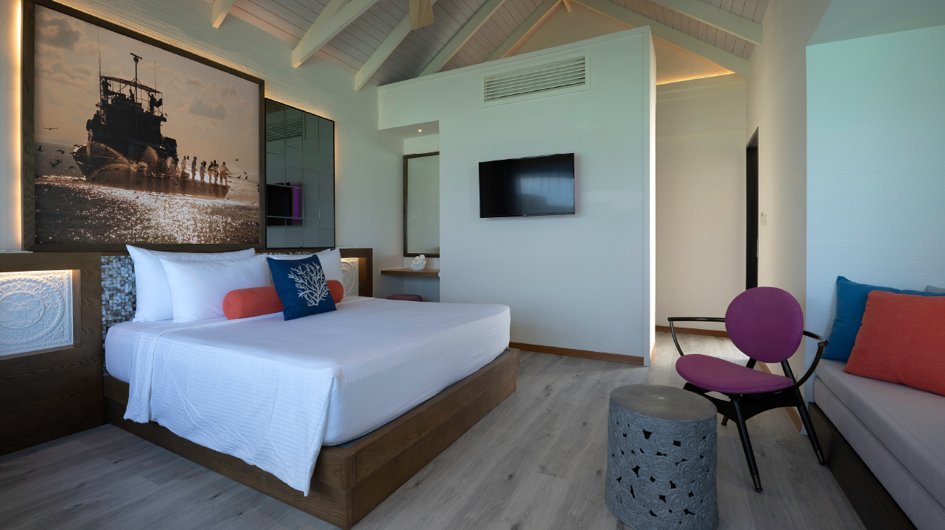
Water Villa - Bedroom

Slide 27
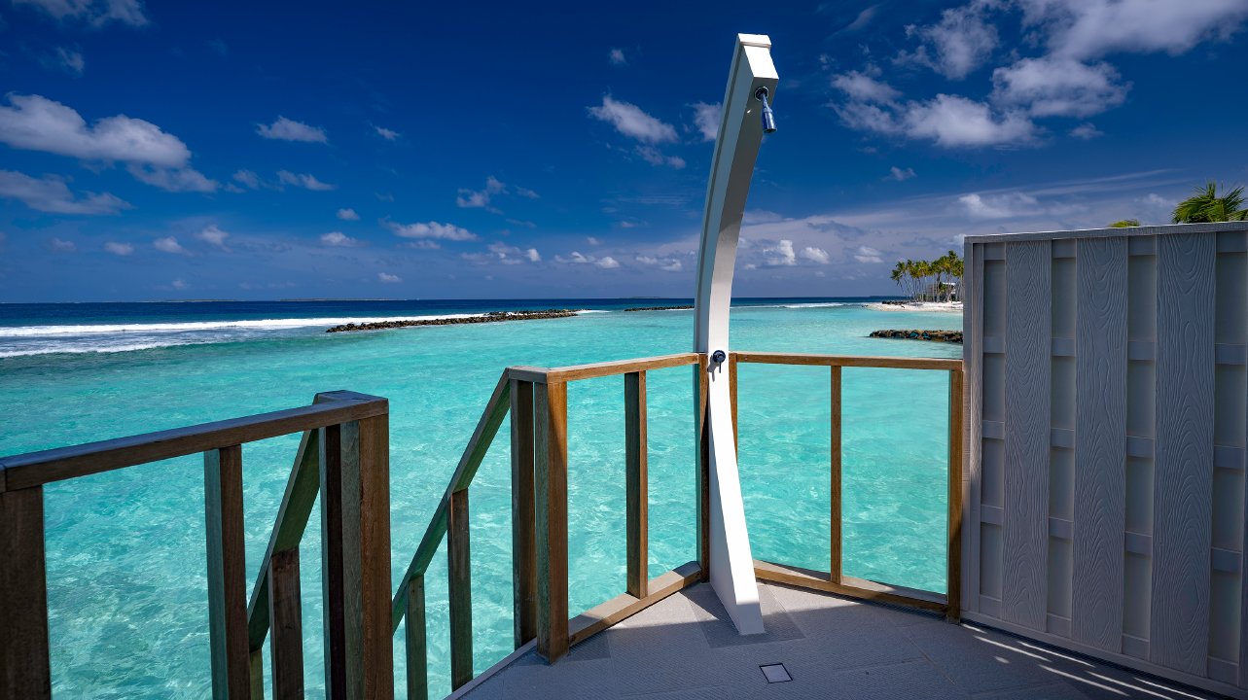
Water Villa – Deck View

Slide 28
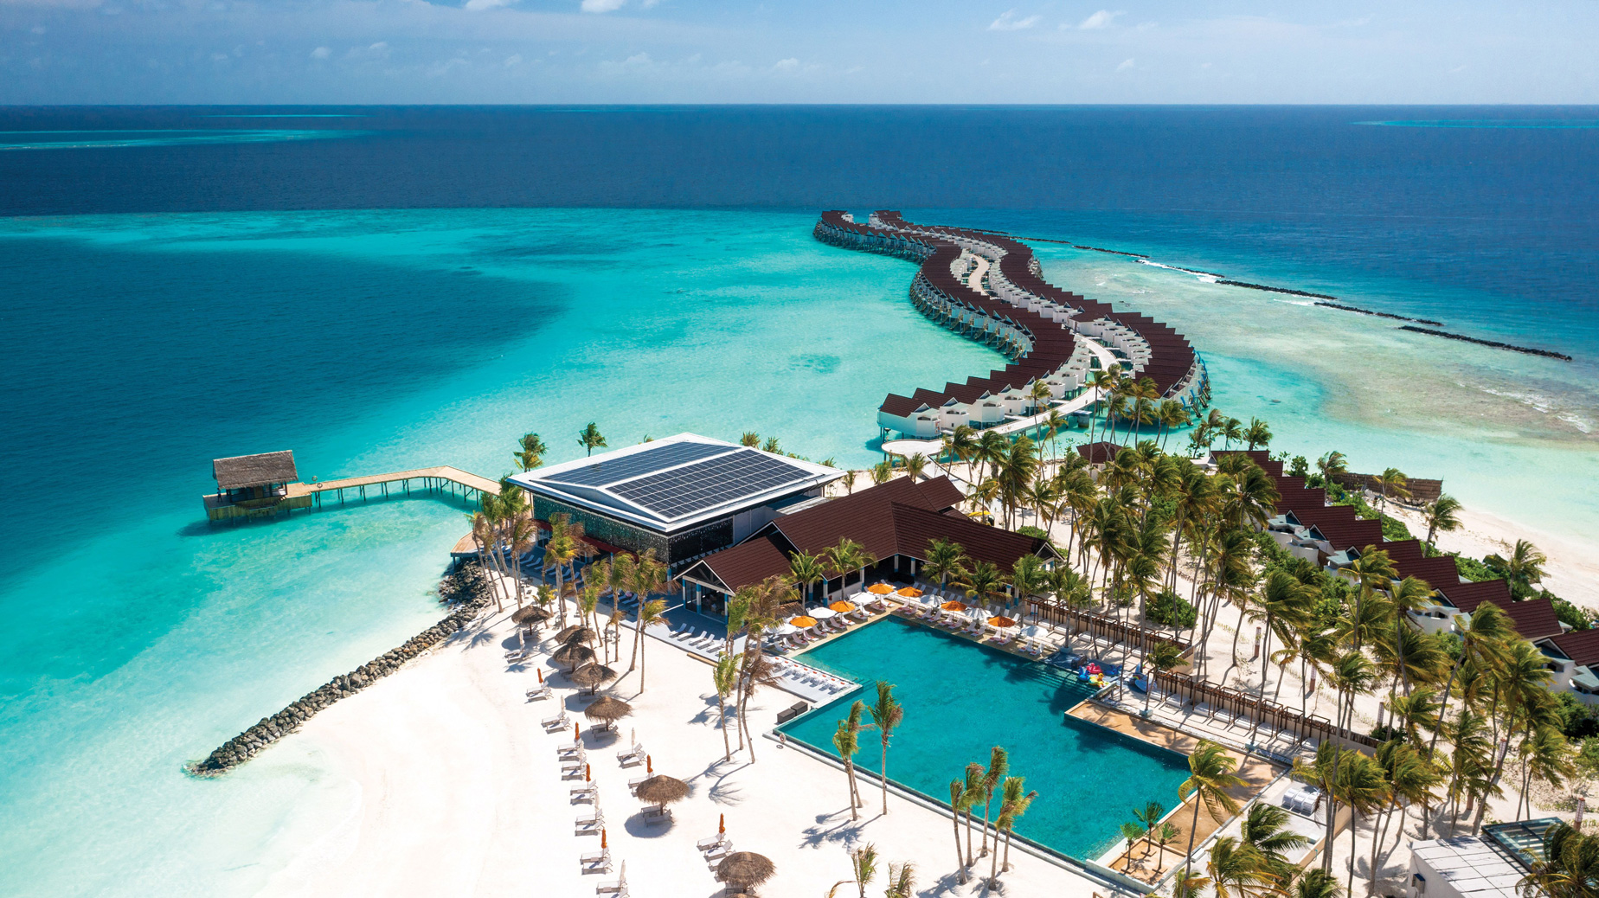
X360 – Pool Bar – Aerial & Generic

Slide 29
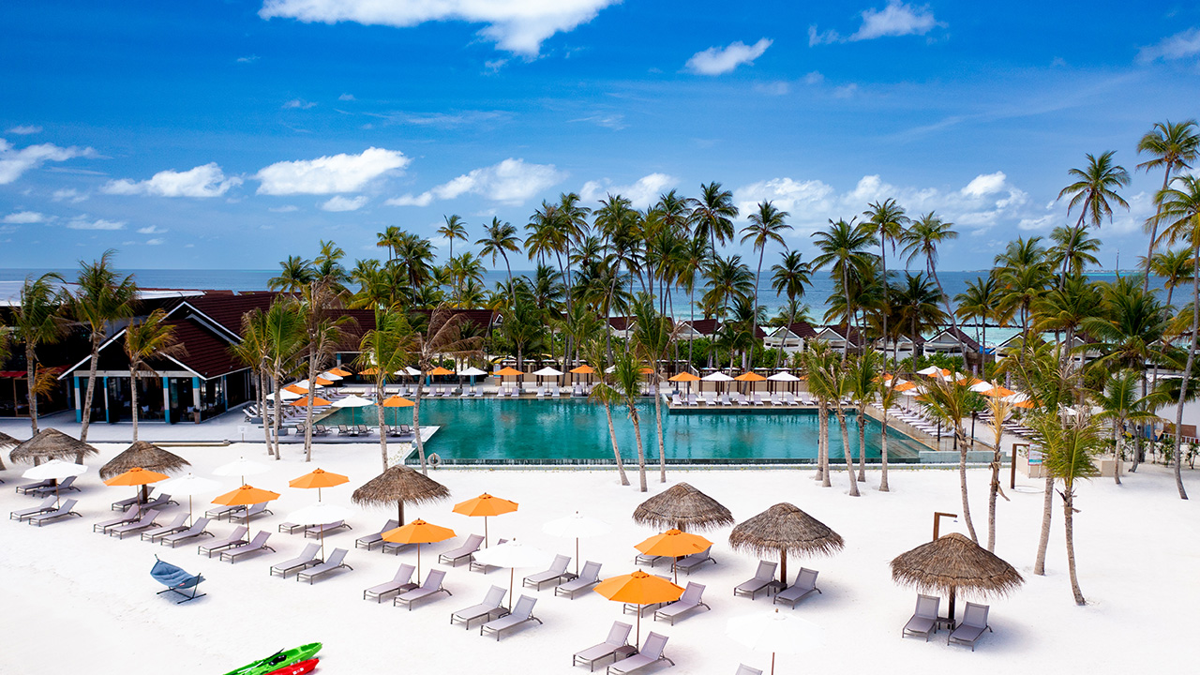
X360 Pool Area

Slide 30
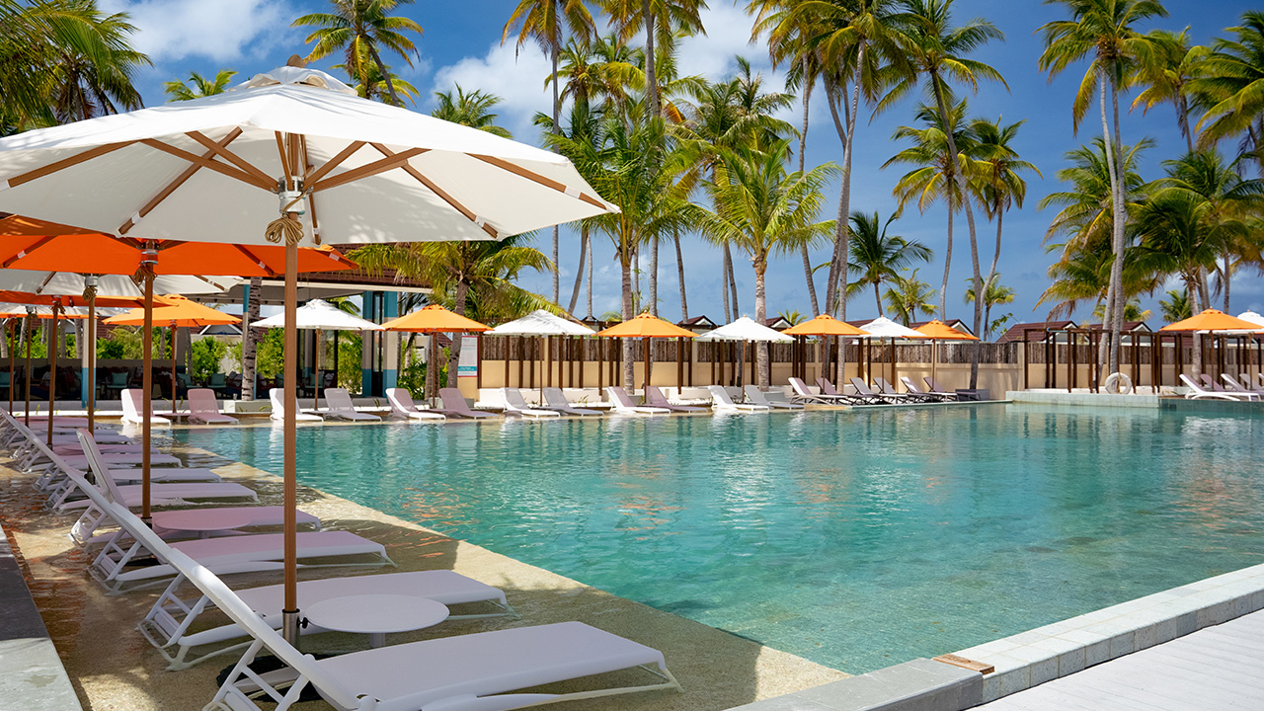
X360 Pool Area

Slide 31
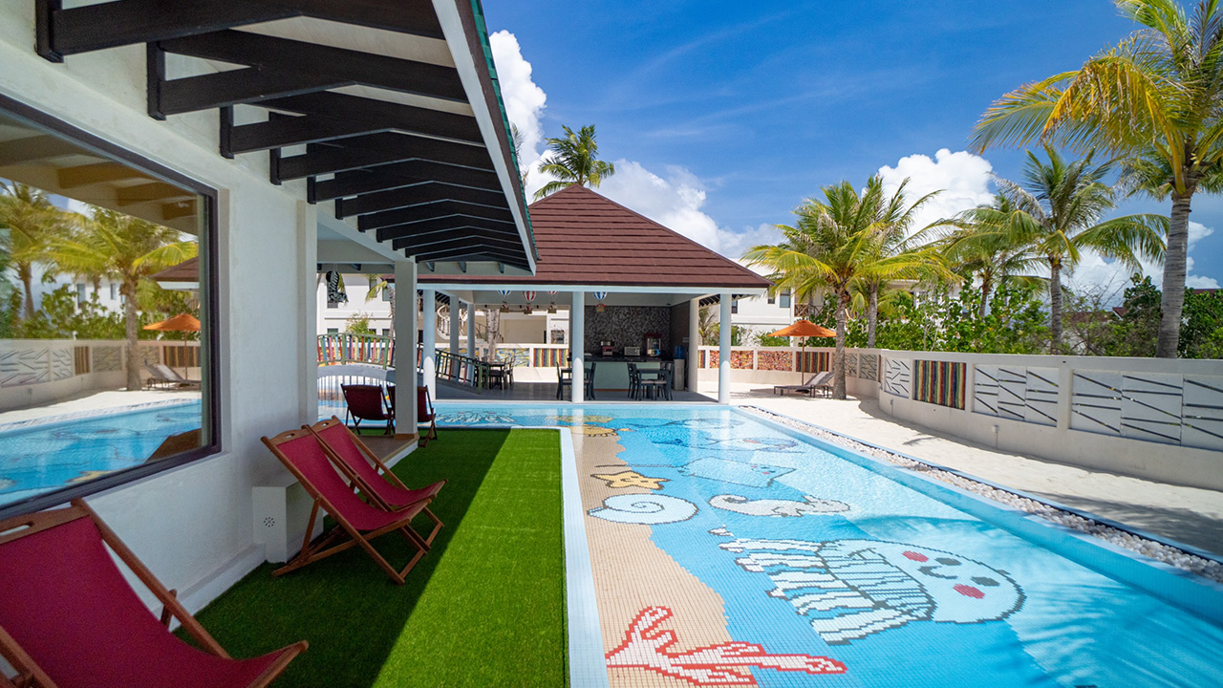
Kids Club

Slide 32
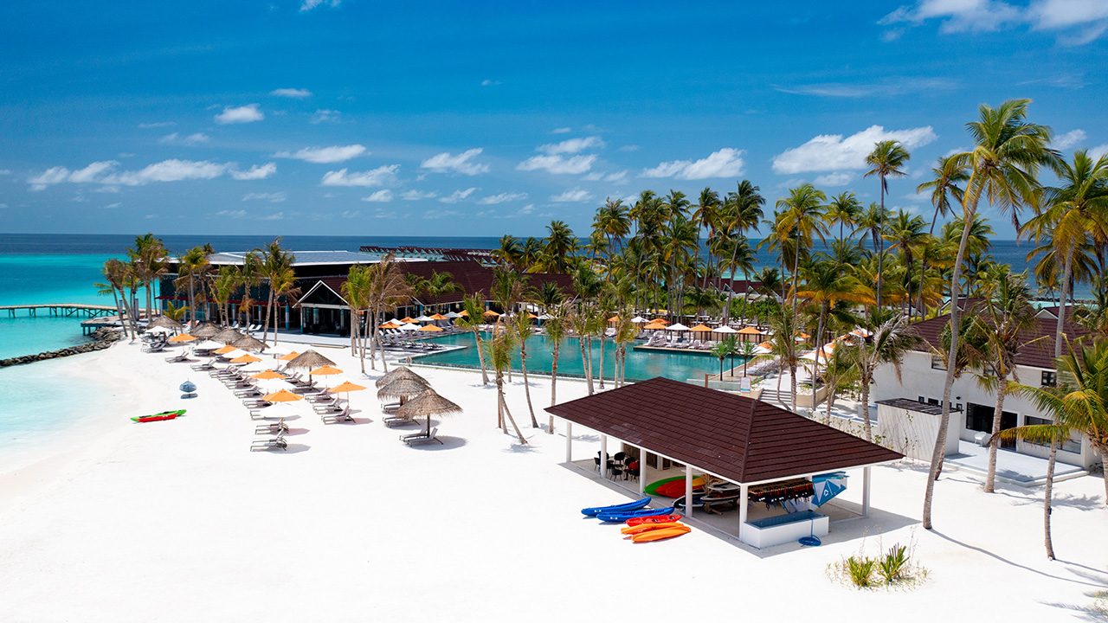
Water Sport Center

Slide 33

Xperience the Magic of Connection

